Slide 1



OpenMapKit
Kampala, Uganda

Slide 2
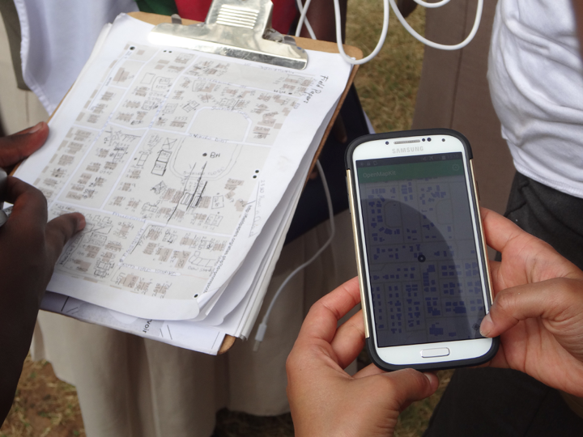

Slide 3


OpenMapKit is an extension of OpenDataKit allowing users to create professional quality mobile data collection surveys for field data collection
Created by the American Red Cross and supported by USAID

Slide 4


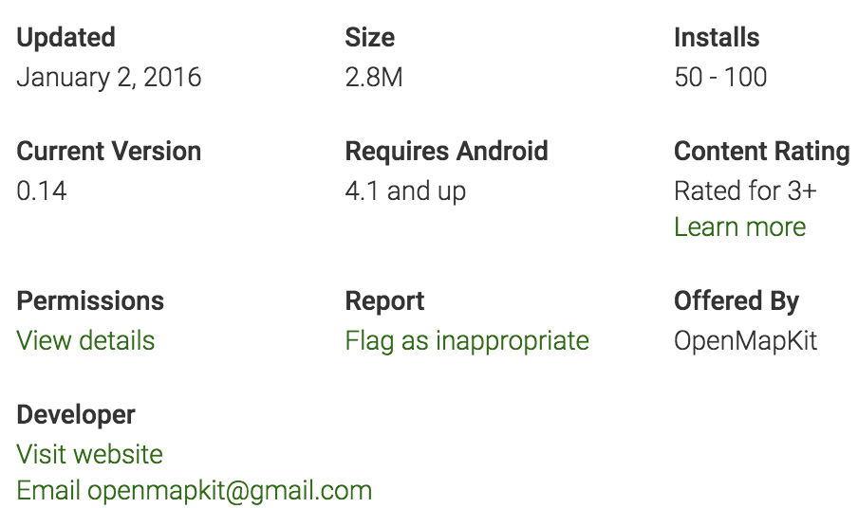

Slide 5
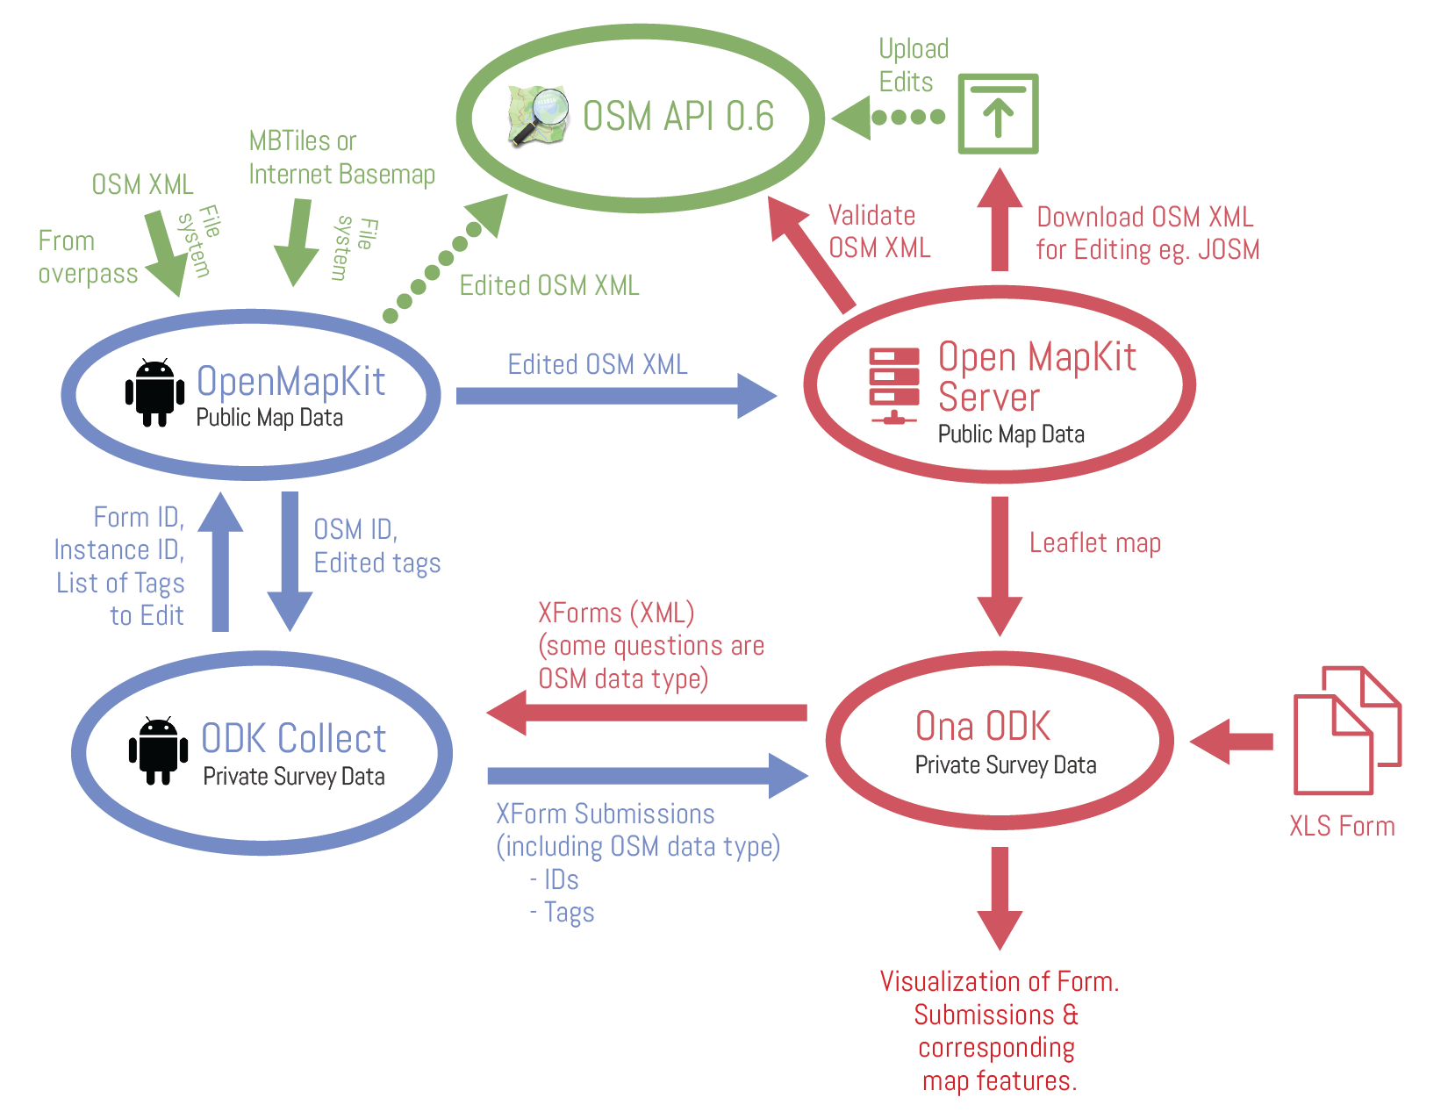

Slide 6
Installation
Get the OMK Installation folder from the USB stick or Google Drive: https://drive.google.com/drive/folders/0Bx3_hrMYdNwLUldWT3hJbGdQa1U
Copy it to the Download folder on your mobile device. This should contain the following files:
ODK Collect ODK_Collect_v1.4.7.apk
OpenMapKit OpenMapKit_v0.14.apk
MBTiles kampala_osm.mbtiles
Baselayers fspmaps_kampala.osm + educationalfacilities_kampala.osm
XForms .xml files (x12)

Slide 7
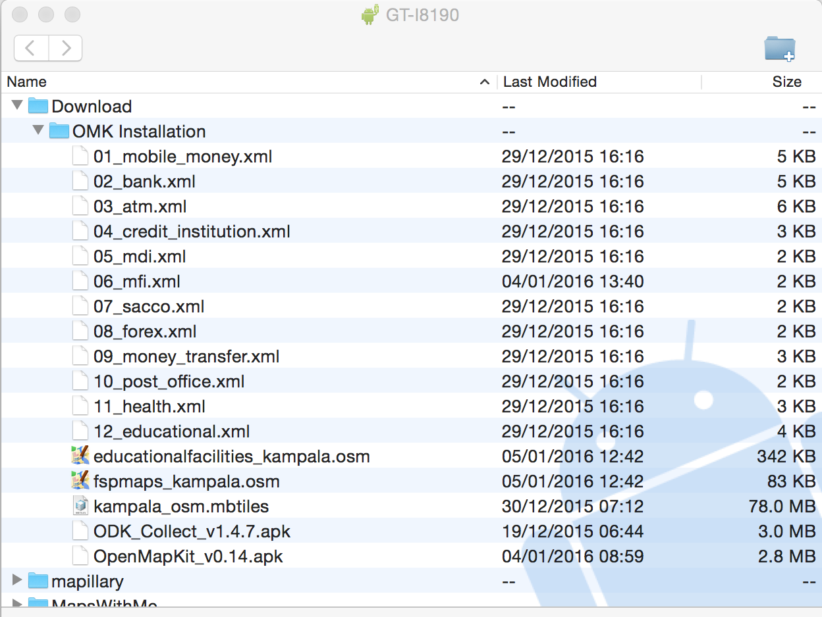

Slide 8
Installation
Install ODK Collect and OMK apps
Double click the ODK_Collect_v1.4.7.apk and OpenMapKit_v0.14.apk files in Download/Installation folder to install applications
ODK Collect and OMK folders
The installation will automatically create the required odk and openmapkit directories on your mobile device

Slide 9
Installation
ODK Collect Xform
Copy all the .xml files to the odk/forms directory on your mobile device
OMK Basemap Tiles
Copy kampala_osm.mbtiles file into the openmapkit/mbtiles directory on your mobile device
OMK OpenStreetMap Layer
Copy all the .osm files to into the openmapkit/osm directory on your mobile device

Slide 10
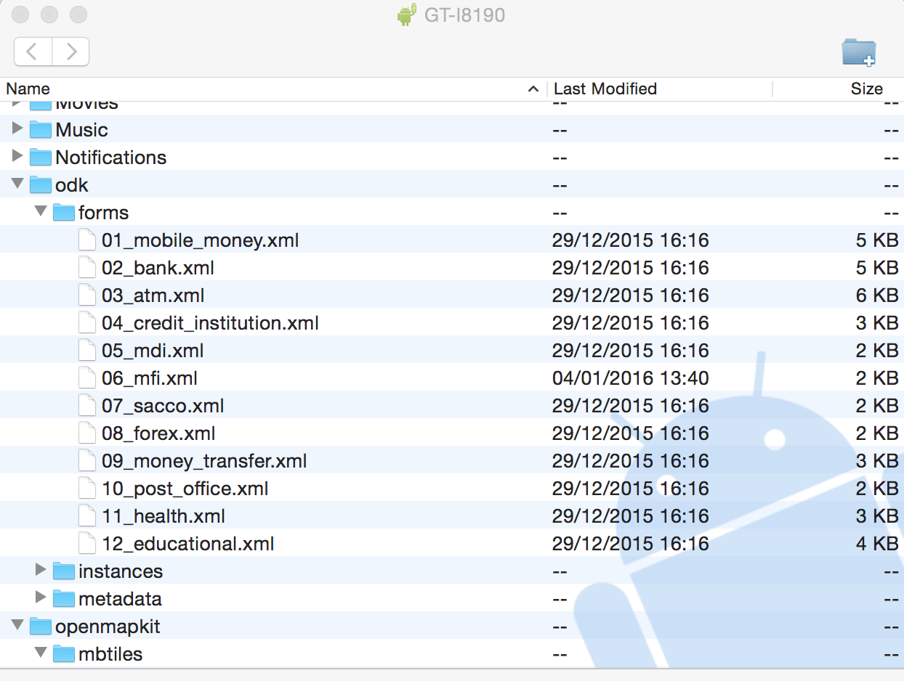

Slide 11
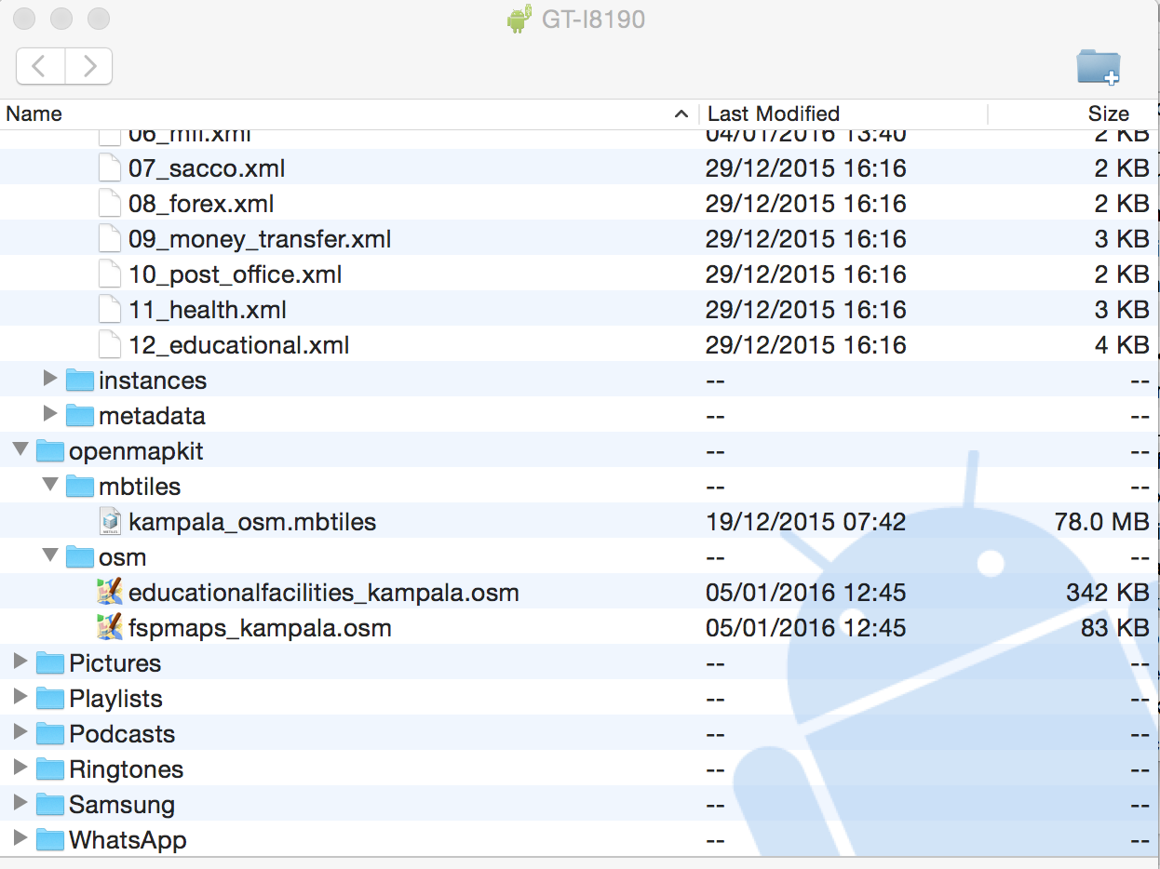

Slide 12


Slide 13
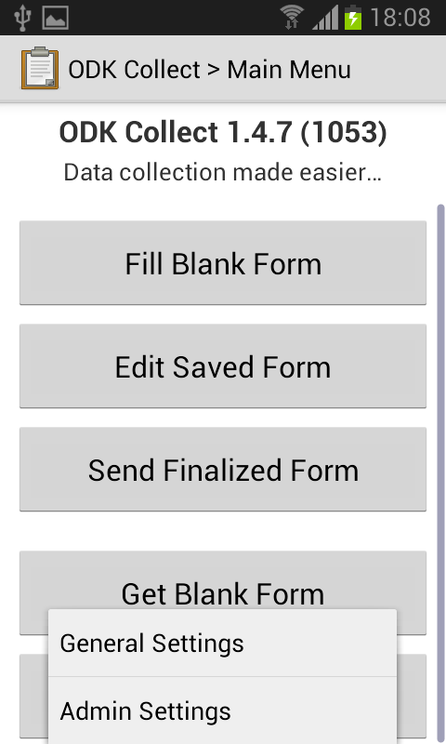
Setup
ODK Collect
Configure Server
Go to General
Settings
Select Configure
platform settings
Edit URL:
http://192.168.43.
147:3210/odk

Slide 14
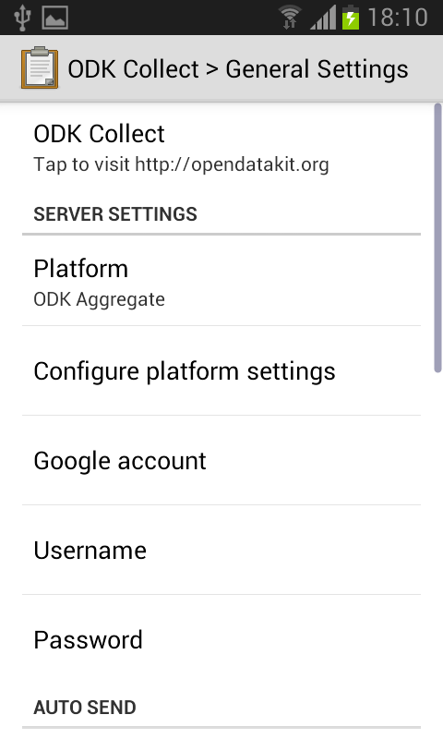
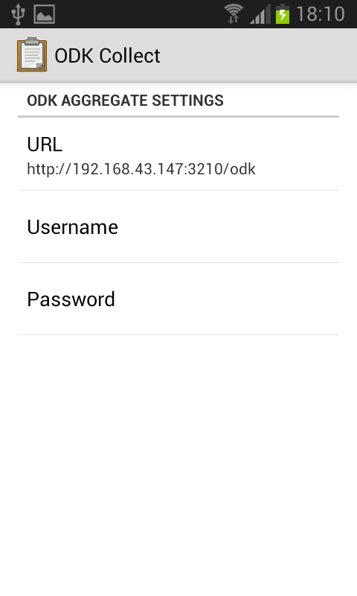

Slide 15
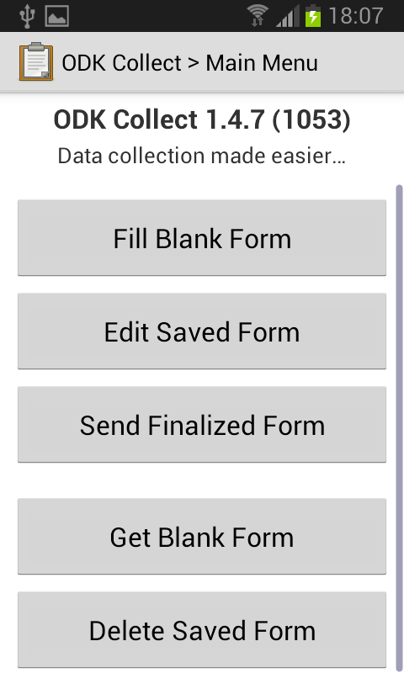
Fill Blank Form
Select Fill Blank Form
Select the 06 MFI form:
01 Mobile Money
02 Bank
03 ATM
04 Credit Institution
05 MDI
06 MFI
07 SACCO
08 Foreign Exchange
09 Misc/Money Transfer
10 Post Office
11 Health Facility
12 Educational Facility

Slide 16
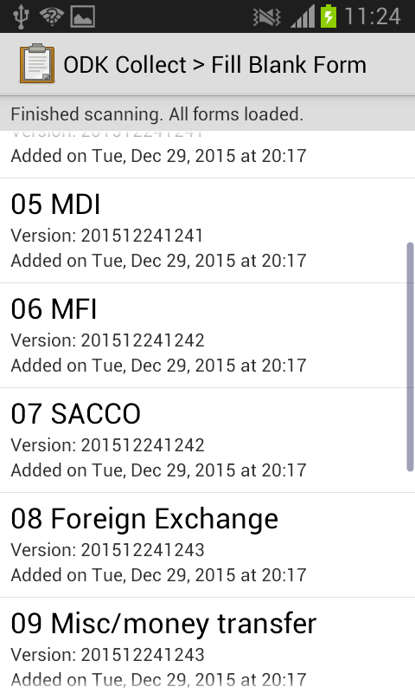
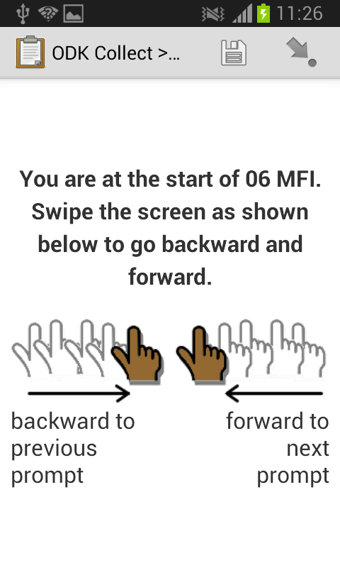

Slide 17
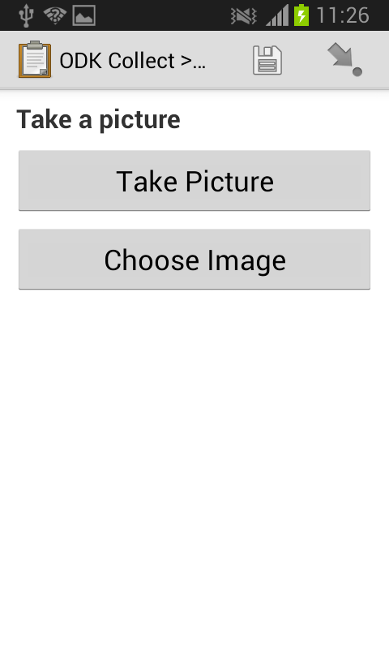

Select Take Picture
Take a picture of the POI
Click Save
Swipe screen left
Select Launch OpenMapKit

Slide 18
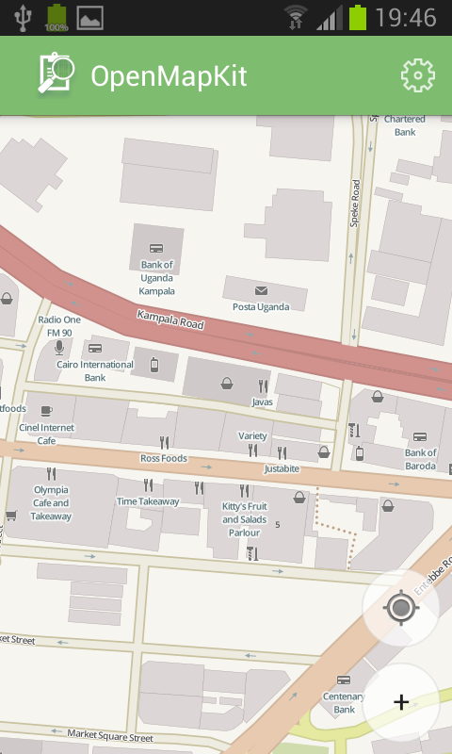
OMK
Configure Basemap
Go to Settings
Choose Basemap
kampala_osm.mbtiles
Click OK

Slide 19
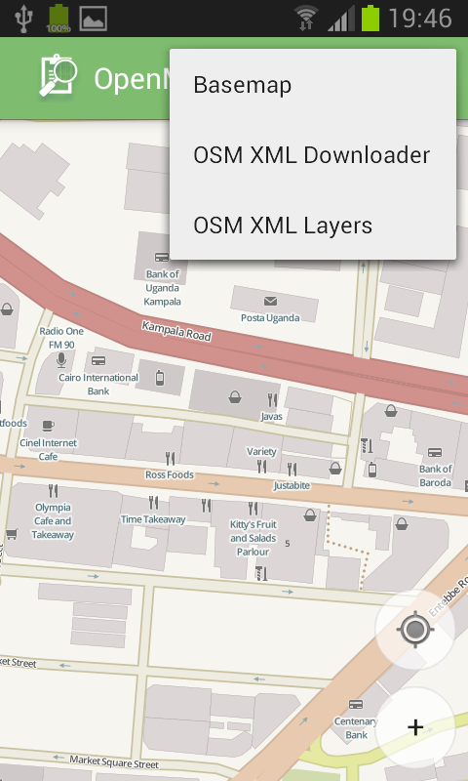
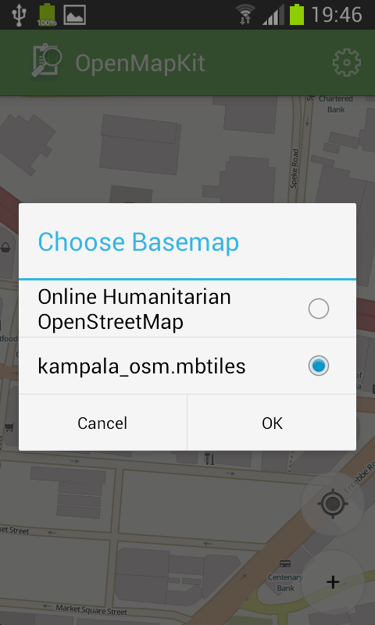

Slide 20
OMK
Configure Layer
Go to Settings
Choose OSM XML
Layer:
fspmaps_kampala.osm
Click OK

Slide 21
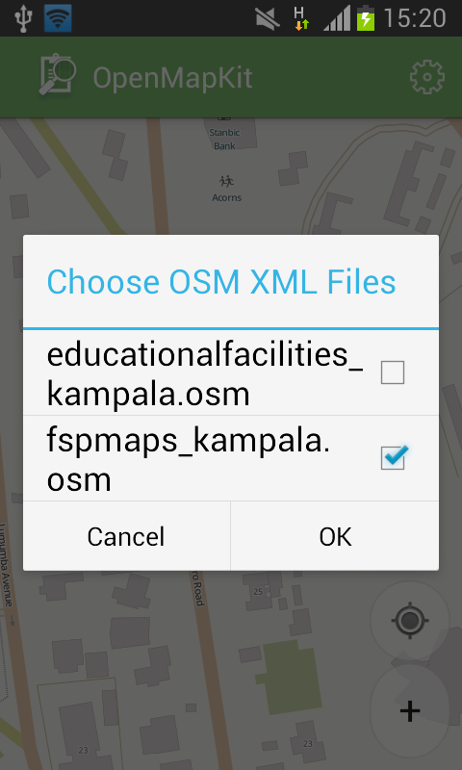

Slide 22
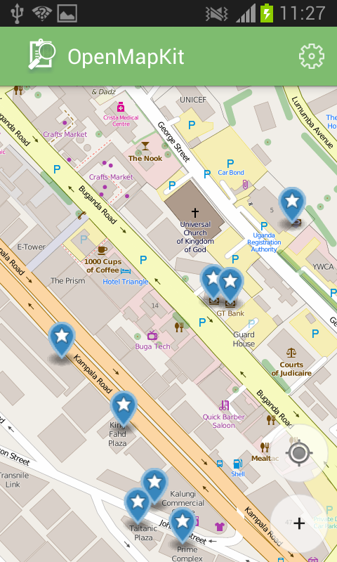
Mapping
OMK
Add POI
Select symbol +
Pan map to move POI
node * to right location
Click + Add Node
Select placed node *
Select first field and
apply appropriate tags
Save tag edits

Slide 23
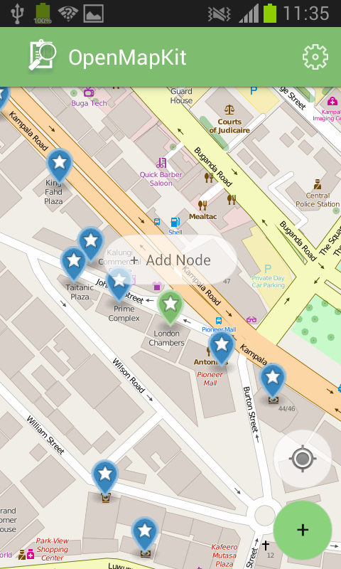
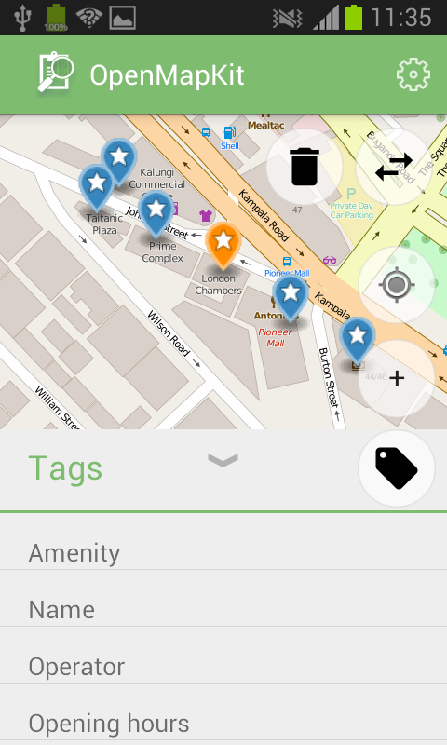

Slide 24
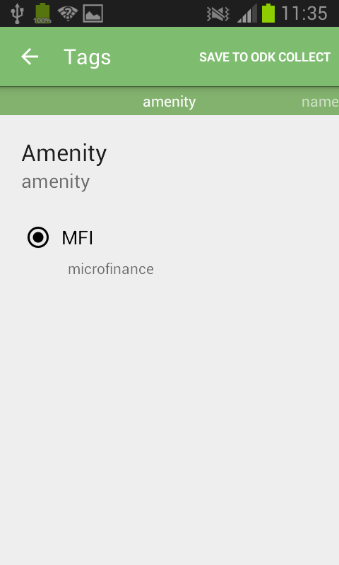
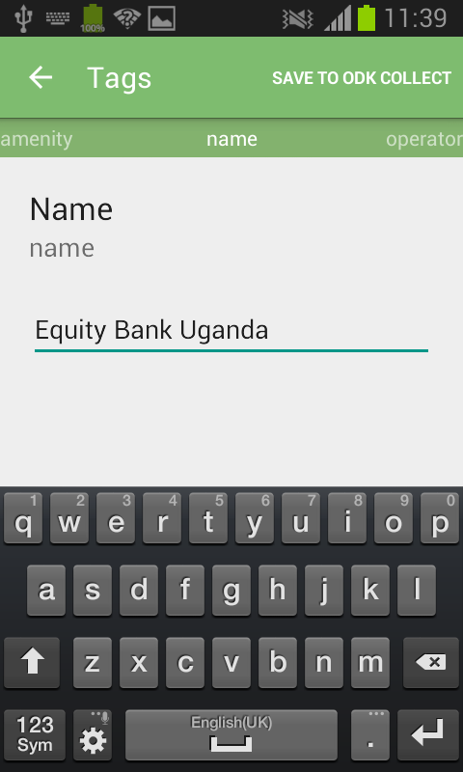

Slide 25
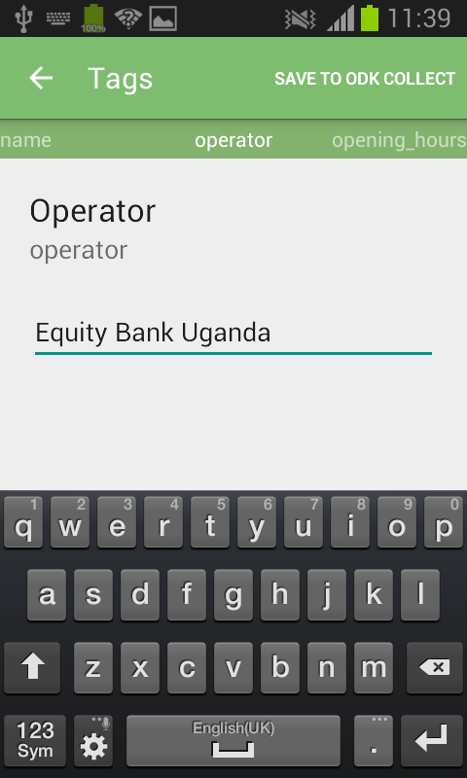
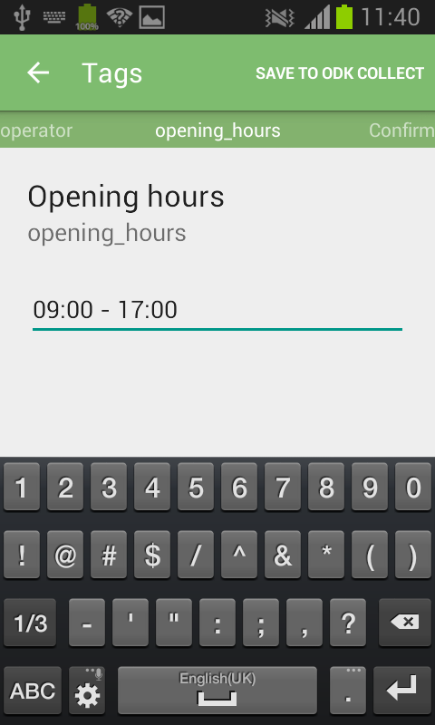

Slide 26
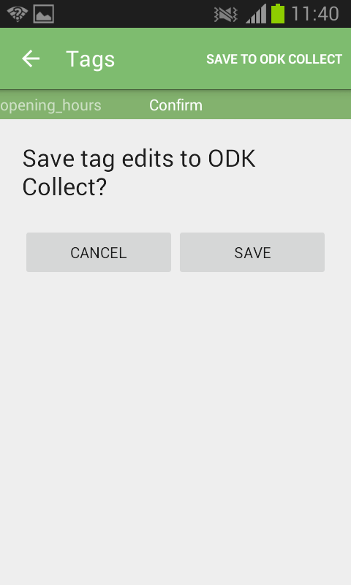

Slide 27
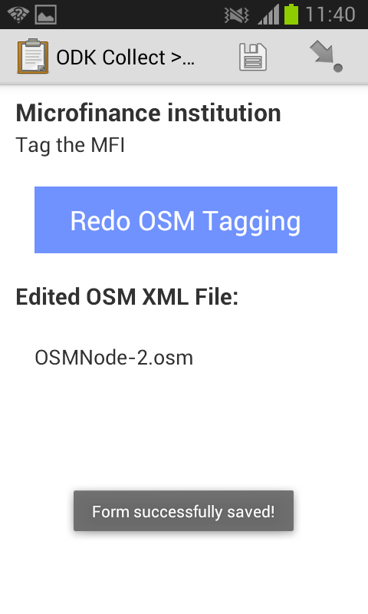
OMK
Save Form
Select save
(disk symbol)
Select finalise
(arrow symbol)
Select Go To End
Tick Mark form as finalized
Select Save Form
and Exit

Slide 28
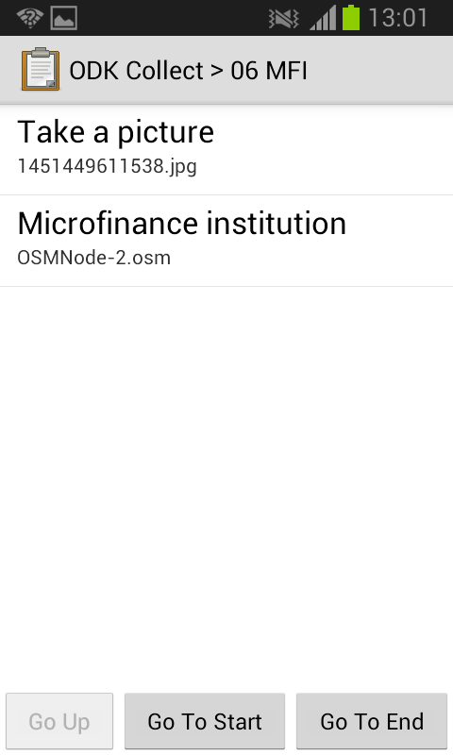
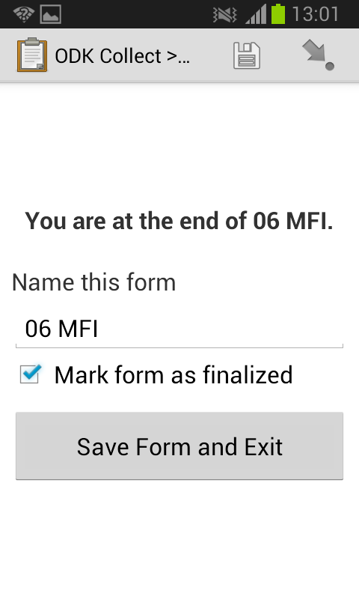

Slide 29
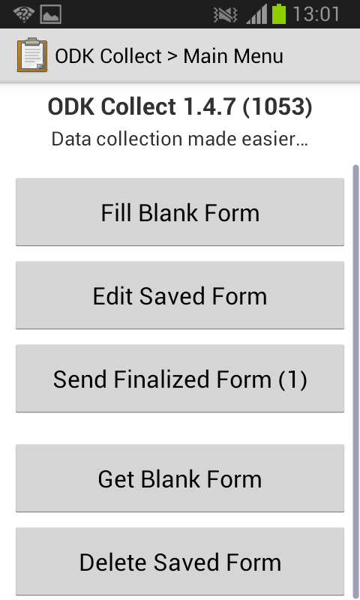
OMK
Send Finalized Form
Select Send
Finalized Form (1)
Tick finalized form(s)
Select
Send Selected

Slide 30
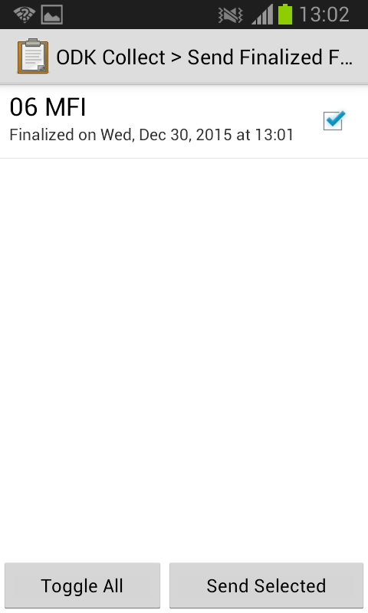

Slide 31
OMK
Copy Finalized Form
Go to odk/instances on mobile device
Select folder(s) from the day
i.e 06_mfi_2015-12-30_11-25-45
Each folder should contain following files:
.xml
.jpg
.osm
Copy the folder(s) to your laptop and to the appropriate location on the #MapUganda external hard drive:
District/Date/Raw i.e (Makerere/06012016/Raw)

Slide 32
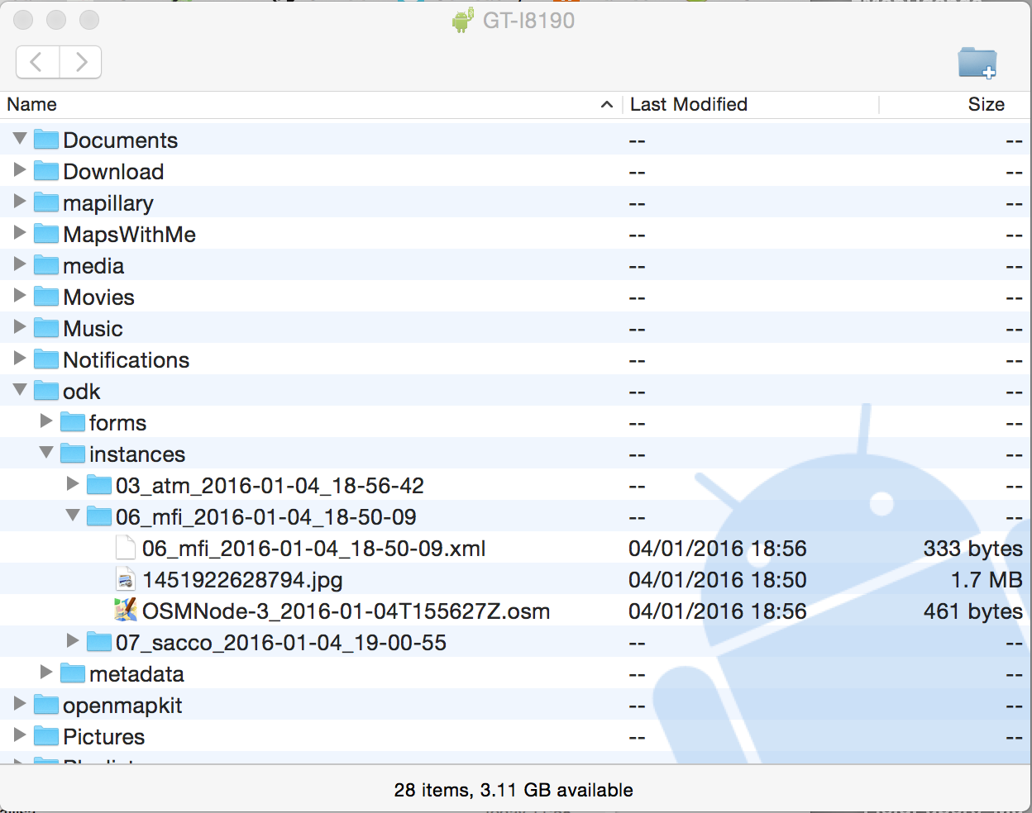

Slide 33
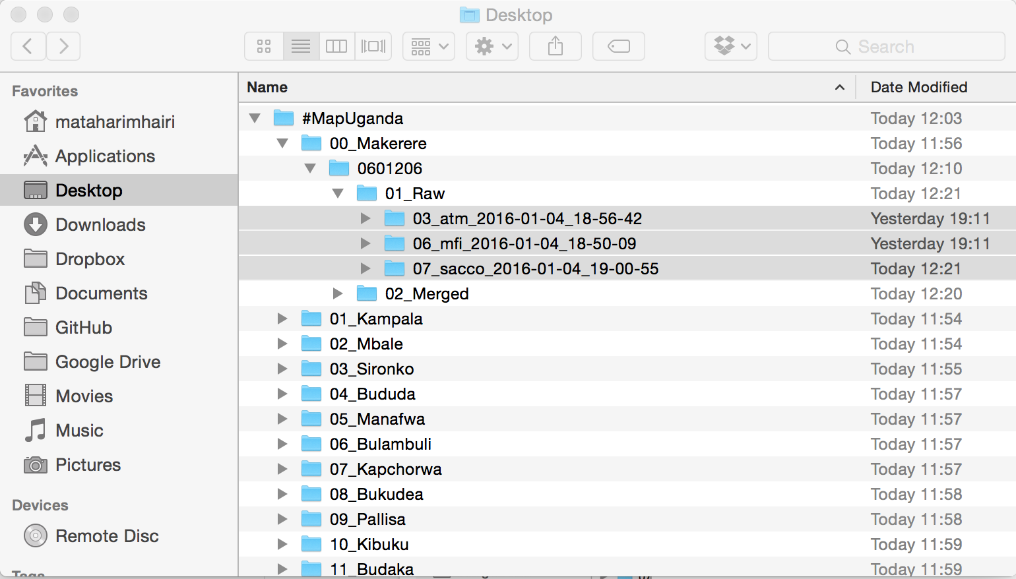
#MapUganda External Hard Drive File Structure

Slide 34
